Slide 1
Zhang’s Camera Calibration
광학솔루션SW개발팀
조성윤

Slide 2
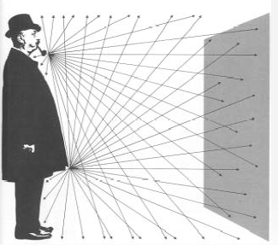
빛의 행동
상(인화지)
상(인화지)에서 파이프를 구분 할 수 있을까?

Slide 3
Pinhole 카메라
차광막을 설치하고 차광막에 작을 구멍(Pinhole)을 뚫어 놓는다면?

Slide 4
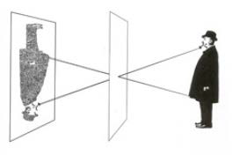
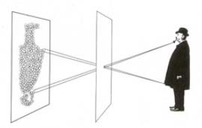
Pinhole 카메라
Pinhole 크기가 작은 경우
(이상적인 Pinhole 카메라는 Pinhole의 크기가 0 이다.)
상이 반전 된다.
Pinhole 크기가 큰 경우
Pinhole 크기가 작을 수록 선명하다. 왜 그러한가?
Pinhole 크기가 작다면 어떤 단점이 있는가?

Slide 5


Pinhole Camera Model
Pinhole
Focal length:$f$
Focal length:$f$
Object
Retina Plane
image Plane

Slide 6





Lens Camera
Pinhole 카메라의 단점을 보완하기 위해 렌즈 카메라를 사용한다.
pinhole 카메라의 Focal length와 렌즈카메라의 Focal length는 같은가?
pinhole 카메라의 Focal length는 Lens Camera의 무엇과 대응되는가?
(1) focal length
(2) Lens position
(3) Lens position - focal length
렌즈 카메라의 단점은 무엇인가?
Pinhole 카메라
Focusing
$d$: Chart(Object) Distance
$f$: Focal Length
Chart (Object)
Pinhole
Image Sensor
$f$: Focal Length
Lens 카메라
Focusing
$d$: Chart(Object) Distance
$p$: Lens Position
Chart (Object)
Lens
Image Sensor

Slide 7








3D 좌표계
$$Y$$
$$Y$$
$$Z$$
$$X$$
$$X$$
$$Z$$
왼손 좌표계
오른손 좌표계
일반적으로, 둘 중 어느 좌표계를 쓰는가?

Slide 8
아핀변환
아핀변환(Affine Transform)
Identity (항등)
Scaling
Reflection (반사)
Shearing (층밀리기)
Rotation (회전)
Translation

Slide 9
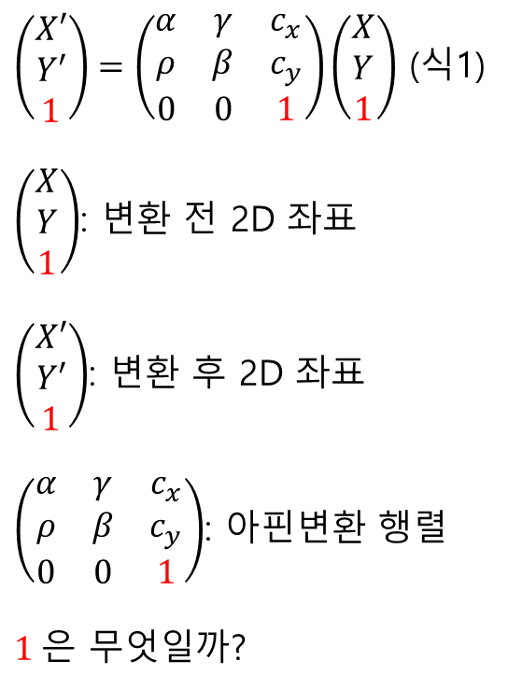
Affine Transform Matrix
$\left(\begin{matrix}X′ \\ Y′ \\ 1\end{matrix}\right)=\left(\begin{matrix}α & γ & c_{x} \\ ρ & β & c_{y} \\ 0 & 0 & 1\end{matrix}\right)\left(\begin{matrix}X \\ Y \\ 1\end{matrix}\right)$ (식1)
$\left(\begin{matrix}X \\ Y \\ 1\end{matrix}\right)$: 변환 전 2D 좌표
$\left(\begin{matrix}X′ \\ Y′ \\ 1\end{matrix}\right)$: 변환 후 2D 좌표
$\left(\begin{matrix}α & γ & c_{x} \\ ρ & β & c_{y} \\ 0 & 0 & 1\end{matrix}\right)$: 아핀변환 행렬
$1$은 무엇일까?

Slide 10

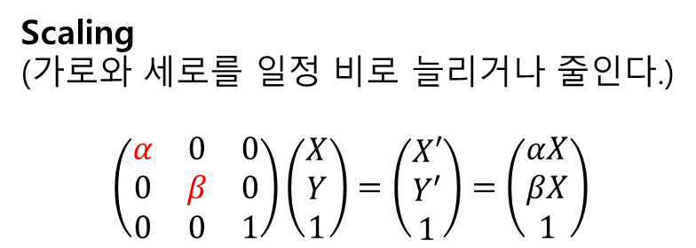

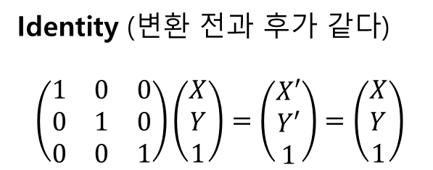






Identity and Scale
$$Y$$
Identity (변환 전과 후가 같다)
$$\left(\begin{matrix}1 & 0 & 0 \\ 0 & 1 & 0 \\ 0 & 0 & 1\end{matrix}\right)\left(\begin{matrix}X \\ Y \\ 1\end{matrix}\right)=\left(\begin{matrix}X′ \\ Y′ \\ 1\end{matrix}\right)=\left(\begin{matrix}X \\ Y \\ 1\end{matrix}\right)$$
$$Y$$
$$X$$
$$X$$
Scaling
(가로와 세로를 일정 비로 늘리거나 줄인다.)
$$\left(\begin{matrix}α & 0 & 0 \\ 0 & β & 0 \\ 0 & 0 & 1\end{matrix}\right)\left(\begin{matrix}X \\ Y \\ 1\end{matrix}\right)=\left(\begin{matrix}X′ \\ Y′ \\ 1\end{matrix}\right)=\left(\begin{matrix}αX \\ βX \\ 1\end{matrix}\right)$$
$$Y$$
$$Y^{′}=αY$$
$$X^{′}=αX$$
$$X$$

Slide 11

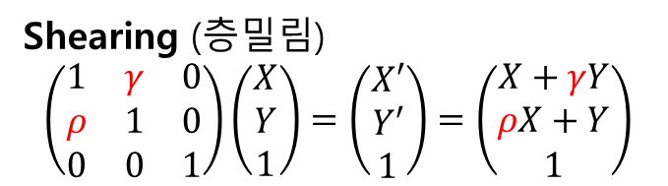

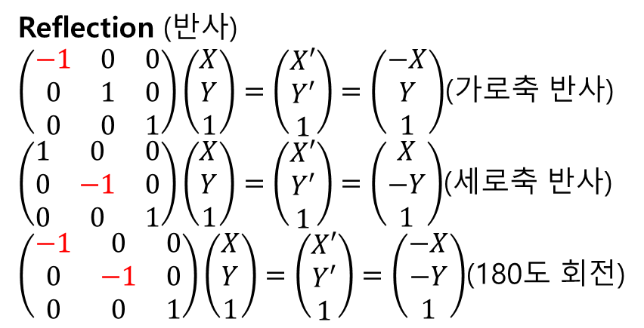




Reflection and Shear
Reflection (반사)
$\left(\begin{matrix}−1 & 0 & 0 \\ 0 & 1 & 0 \\ 0 & 0 & 1\end{matrix}\right)\left(\begin{matrix}X \\ Y \\ 1\end{matrix}\right)=\left(\begin{matrix}X′ \\ Y′ \\ 1\end{matrix}\right)=\left(\begin{matrix}−X \\ Y \\ 1\end{matrix}\right)$(가로축 반사)
$\left(\begin{matrix}1 & 0 & 0 \\ 0 & −1 & 0 \\ 0 & 0 & 1\end{matrix}\right)\left(\begin{matrix}X \\ Y \\ 1\end{matrix}\right)=\left(\begin{matrix}X′ \\ Y′ \\ 1\end{matrix}\right)=\left(\begin{matrix}X \\ −Y \\ 1\end{matrix}\right)$(세로축 반사)
$\left(\begin{matrix}−1 & 0 & 0 \\ 0 & −1 & 0 \\ 0 & 0 & 1\end{matrix}\right)\left(\begin{matrix}X \\ Y \\ 1\end{matrix}\right)=\left(\begin{matrix}X′ \\ Y′ \\ 1\end{matrix}\right)=\left(\begin{matrix}−X \\ −Y \\ 1\end{matrix}\right)$(180도 회전)
$$Y$$
가로축 반전
$$X$$
$$Y$$
$$X$$
Shearing (층밀림)
$$\left(\begin{matrix}1 & γ & 0 \\ ρ & 1 & 0 \\ 0 & 0 & 1\end{matrix}\right)\left(\begin{matrix}X \\ Y \\ 1\end{matrix}\right)=\left(\begin{matrix}X′ \\ Y′ \\ 1\end{matrix}\right)=\left(\begin{matrix}X+γY \\ ρX+Y \\ 1\end{matrix}\right)$$
$$X^{′}=X+γY$$
$$Y$$
$Y^{′}=ρX+Y=Y,$ $ρ=0$
$ρ$가 0일 경우 X축으로 만 밀림
$$X$$

Slide 12


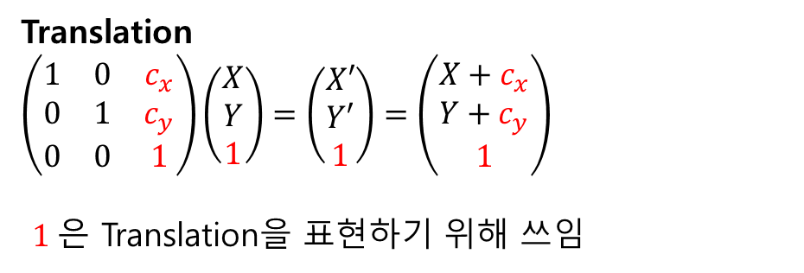

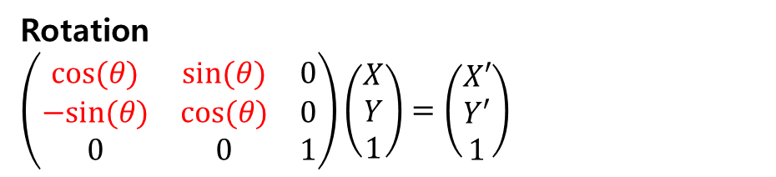






Rotation and Translation
$$Y$$
$$X$$
Rotation
$\left(\begin{matrix}cos⁡(θ) & sin⁡(θ) & 0 \\ −sin⁡(θ) & cos⁡(θ) & 0 \\ 0 & 0 & 1\end{matrix}\right)\left(\begin{matrix}X \\ Y \\ 1\end{matrix}\right)=\left(\begin{matrix}X′ \\ Y′ \\ 1\end{matrix}\right)$
$$Y$$
Translation
$\left(\begin{matrix}1 & 0 & c_{x} \\ 0 & 1 & c_{y} \\ 0 & 0 & 1\end{matrix}\right)\left(\begin{matrix}X \\ Y \\ 1\end{matrix}\right)=\left(\begin{matrix}X′ \\ Y′ \\ 1\end{matrix}\right)=\left(\begin{matrix}X+c_{x} \\ Y+c_{y} \\ 1\end{matrix}\right)$
$1$은 Translation을 표현하기 위해 쓰임
$$X$$
$$Y$$
$$Y$$
$$(c_{x},c_{y})$$
$$X$$
$$X$$

Slide 13
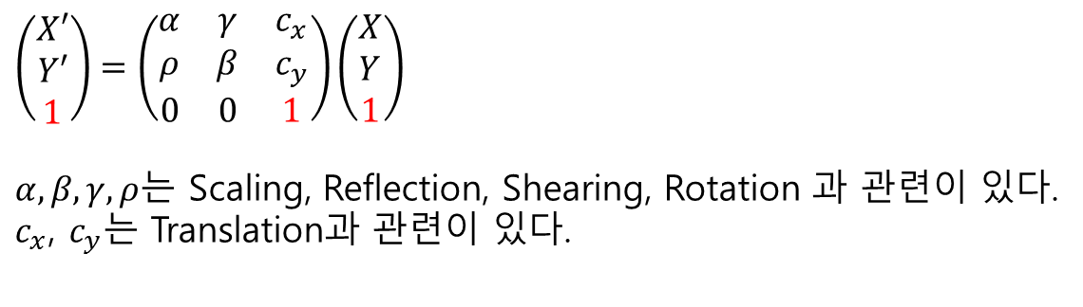

Rotation and Translation
Rotation and Translation
$$\left(\begin{matrix}cos⁡(θ) & sin⁡(θ) & c_{x} \\ −sin⁡(θ) & cos⁡(θ) & c_{y} \\ 0 & 0 & 1\end{matrix}\right)\left(\begin{matrix}X \\ Y \\ 1\end{matrix}\right)=\left(\begin{matrix}X′ \\ Y′ \\ 1\end{matrix}\right)$$
Q: 위의 변환에서, Rotation과 Translation중 어는 것이 먼저 변환되었는가?
$\left(\begin{matrix}X′ \\ Y′ \\ 1\end{matrix}\right)=\left(\begin{matrix}α & γ & c_{x} \\ ρ & β & c_{y} \\ 0 & 0 & 1\end{matrix}\right)\left(\begin{matrix}X \\ Y \\ 1\end{matrix}\right)$
$α,β,γ,ρ$는 Scaling, Reflection, Shearing, Rotation 과 관련이 있다.
$c_{x}$, $c_{y}$는 Translation과 관련이 있다.

Slide 14







Pinhole Camera Model (Camera Coordinate)
$X^{′}:$ Camera Coordinate (Cartesian)
Object on Image Plane
Object in Camera Coordinate:
$X^{′}={\left(X′,Y′,Z′\right)}^{T}$
$$Y′$$
Pinhole: $X_{o}^{′}{=\left(0,0,0\right)}^{T}$
$$X′$$
$$Z′$$
Focal length:$f$
Image(Retina) Plane
Pinhole

Slide 15

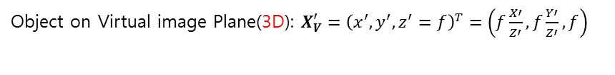







Pinhole Camera Model (3D Virtual Image Plane)
$X^{′}:$ Camera Coordinate (Cartesian)
Object in Camera Coordinate:
$X^{′}={\left(X′,Y′,Z′\right)}^{T}$
$$Y′$$
Object on Virtual Plane(3D): $X_{V}^{′}={\left(x′,y′,f\right)}^{T}$
Object on Image Plane
$$Y′$$
Pinhole: $X_{o}^{′}={\left(0,0,0\right)}^{T}$
$$X′$$
$$X′$$
$$Z′$$
Focal length:$f$
Focal length:$f$
Image(Retina) Plane
Pinhole
Virtual Image Plane(3D)
Object on Virtual image Plane(3D): $X_{V}^{′}={\left(x^{′},y^{′},z^{′}=f\right)}^{T}=\left(f\frac{X′}{Z′}, f\frac{Y′}{Z′},f\right)$
$$Z′$$
$X′$ or $Y′$
Focal length:$f$

Slide 16


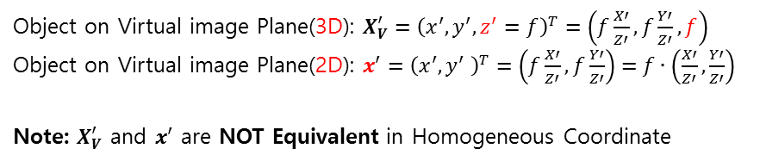


Pinhole Camera Model (2D Virtual Image Plane)
$X^{′}:$ Camera Coordinate (Cartesian)
Object in Camera Coordinate:
$X^{′}={\left(X′,Y′,Z′\right)}^{T}$
$$x′$$
Object on Virtual Plane(2D): $x_{V}^{′}={\left(x′,y′\right)}^{T}$
$$Y′$$
Pinhole: $X_{o}^{′}={\left(0,0,0\right)}^{T}$
$$X′$$
$$y′$$
$$Z′$$
Focal length:$f$
Pinhole
Virtual Image Plane(2D)
Object on Virtual image Plane(3D): $X_{V}^{′}={\left(x^{′},y^{′},z^{′}=f\right)}^{T}=\left(f\frac{X′}{Z′}, f\frac{Y′}{Z′},f\right)$
Object on Virtual image Plane(2D): $x_{}^{′}={\left(x^{′},y^{′} \right)}^{T}=\left(f\frac{X′}{Z′}, f\frac{Y′}{Z′}\right)=f∙\left(\frac{X′}{Z′}, \frac{Y′}{Z′}\right)$
Note: $X_{V}^{′}$ and $x_{}^{′}$ are NOT Equivalent in Homogeneous Coordinate
$$Z′$$
$X′$ or $Y′$
Focal length:$f$

Slide 17
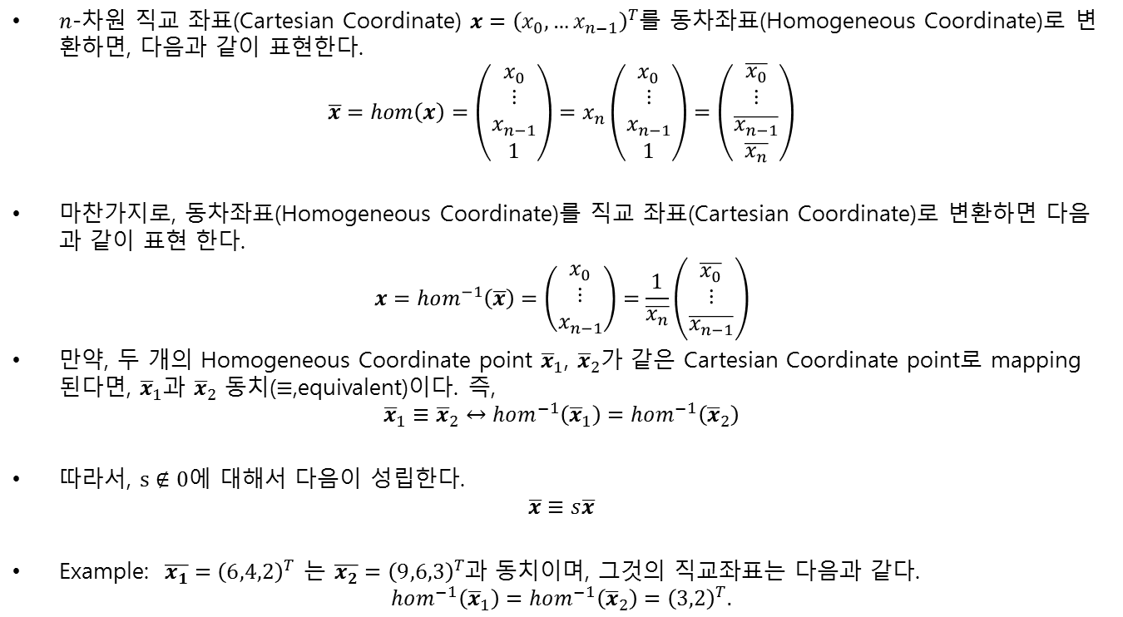
Homogeneous Coordinate
$n$-차원 직교 좌표(Cartesian Coordinate) $x={\left(x_{0},…x_{n−1}\right)}^{T}$를 동차좌표(Homogeneous Coordinate)로 변환하면, 다음과 같이 표현한다.
$$\overline{x}=hom\left(x\right)=\left(\begin{aligned}\begin{matrix}x_{0} \\ ⋮ \\ x_{n−1}\end{matrix} \\ 1\end{aligned}\right)=x_{n}\left(\begin{aligned}\begin{matrix}x_{0} \\ ⋮ \\ x_{n−1}\end{matrix} \\ 1\end{aligned}\right)=\left(\begin{aligned}\begin{matrix}\overline{x_{0}} \\ ⋮ \\ \overline{x_{n−1}}\end{matrix} \\ \overline{x_{n}}\end{aligned}\right)$$
마찬가지로, 동차좌표(Homogeneous Coordinate)를 직교 좌표(Cartesian Coordinate)로 변환하면 다음과 같이 표현 한다.
$$x=hom^{−1}\left(\overline{x}\right)=\left(\begin{matrix}x_{0} \\ ⋮ \\ x_{n−1}\end{matrix}\right)=\frac{1}{\overline{x_{n}}}\left(\begin{matrix}\overline{x_{0}} \\ ⋮ \\ \overline{x_{n−1}}\end{matrix}\right)$$
만약, 두 개의 Homogeneous Coordinate point ${\overline{x}}_{1}$, ${\overline{x}}_{2}$가 같은 Cartesian Coordinate point로 mapping 된다면, ${\overline{x}}_{1}$과 ${\overline{x}}_{2}$ 동치($≡$,equivalent)이다. 즉,
$${\overline{x}}_{1}≡{\overline{x}}_{2}↔hom^{−1}\left({\overline{x}}_{1}\right)=hom^{−1}\left({\overline{x}}_{2}\right)$$
따라서, $s∉0$에 대해서 다음이 성립한다.
$$\overline{x}≡s\overline{x}$$
Example: $\overline{x_{1}}={\left(6,4,2\right)}^{T}$ 는 $\overline{x_{2}}={\left(9,6,3\right)}^{T}$과 동치이며, 그것의 직교좌표는 다음과 같다.
$$hom^{−1}\left({\overline{x}}_{1}\right)=hom^{−1}\left({\overline{x}}_{2}\right)={\left(3,2\right)}^{T}.$$

Slide 18





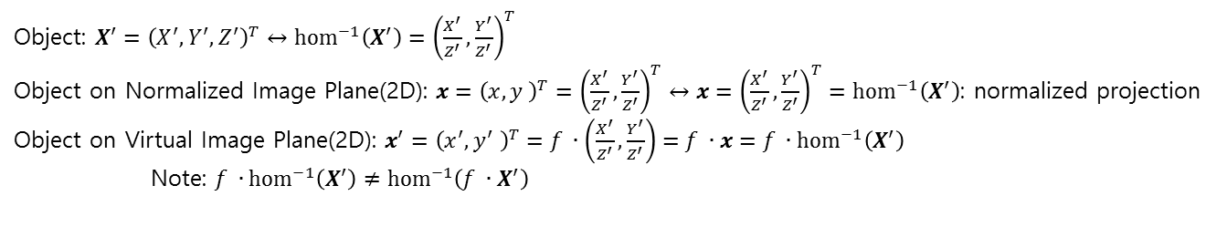





Pinhole Camera Model (Normalized Image Plane)
$X^{′}:$ Camera Coordinate (Cartesian)
Object on Virtual Image Plane(2D): $x_{}^{′}={\left(x′,y′\right)}^{T}$
$$Y′$$
$$y′$$
$$x$$
Object: $X^{′}={\left(X′,Y′,Z′\right)}^{T}$
Pinhole: $X_{o}^{′}={\left(0,0,0\right)}^{T}$
$$X′$$
$$x′$$
$$y$$
$$Z′$$
Focal length:$f$
Object on Normalized Image Plane(2D)
: $x{\left(x,y\right)}^{T}$
1
Pinhole
Virtual Image Plane(2D)
Normalized Image Plane(2D)
Object: $X^{′}={\left(X^{′},Y^{′},Z^{′}\right)}^{T}↔{hom}^{−1}\left(X^{′}\right)={\left(\frac{X^{′}}{Z^{′}},\frac{Y^{′}}{Z^{′}}\right)}^{T}$
Object on Normalized Image Plane(2D): $x={\left(x,y \right)}^{T}={\left(\frac{X^{′}}{Z^{′}},\frac{Y^{′}}{Z^{′}}\right)}^{T}↔x={\left(\frac{X^{′}}{Z^{′}},\frac{Y^{′}}{Z^{′}}\right)}^{T}={hom}^{−1}\left(X^{′}\right)$: normalized projection
Object on Virtual Image Plane(2D): $x_{}^{′}={\left(x^{′},y^{′} \right)}^{T}=f ∙\left(\frac{X^{′}}{Z^{′}}, \frac{Y^{′}}{Z^{′}}\right)=f ∙x=f ∙{hom}^{−1}\left(X^{′}\right)$
Note: $f ∙{hom}^{−1}\left(X^{′}\right)≠{hom}^{−1}\left(f ∙X^{′}\right)$

Slide 19

Projection Matrix
Projection Matrix($M_{p}$): Project object point $X^{′}$ to virtual image point $x_{}^{′}$.
$$x_{}^{′}={\left(x^{′},y^{′} \right)}^{T}=f ∙{hom}^{−1}\left(X^{′}\right)={hom}^{−1}\left(\underset{M_{p}}{\underbrace{\left(\begin{matrix}f & 0 & 0 \\ 0 & f & 0 \\ 0 & 0 & 1\end{matrix}\right)}}X^{′}\right)$$
Using Normalized Coordinate $x={\left(x,y \right)}^{T}$,
$$x_{V}^{′}={\left(x^{′},y^{′} \right)}^{T}=f ∙{hom}^{−1}\left(X^{′}\right)=f ∙x={hom}^{−1}\left(\underset{M_{p}}{\underbrace{\left(\begin{matrix}f & 0 & 0 \\ 0 & f & 0 \\ 0 & 0 & 1\end{matrix}\right)}}\left(\begin{matrix}x \\ y \\ 1\end{matrix}\right)\right)={hom}^{−1}\left(M_{p}\left(\begin{matrix}x \\ 1\end{matrix}\right)\right)$$

Slide 20





Image Sensor Coordinate
$X^{′}:$ Camera Coordinate (Cartesian)
Object on Virtual Image Plane(2D): $x_{}^{′}={\left(x′,y′\right)}^{T}$
Object on Image Plane(2D): $u={\left(u,v\right)}^{T}$
Object in Camera Coordinate:
$X^{′}={\left(X′,Y′,Z′\right)}^{T}$
$$u$$
Pinhole: $X_{o}^{′}={\left(0,0,0\right)}^{T}$
$$X′$$
$$x′$$
$$y$$
$$Z′$$
Focal length:$f$
Object on Normalized Image Plane(2D)
: $x{\left(x,y\right)}^{T}$
$$Y′$$
$$y′$$
1
$$x$$
$$v$$
Pinhole
Virtual Image Plane(2D)
& Image Sensor Plane(2D)
Normalized Image Plane(2D)
Image Sensor Plane은 Virtual Image Plane 위에 위치한다.
Image Sensor Coordinate는 $u={\left(u,v\right)}^{T}$로 표현하며, 단위는 Pixel이다.

Slide 21









Image Sensor Coordinate
Image Sensor Plane(2D)
$$u$$
$$x′$$
Virtual Image Plane(2D)
Pixel height
Pinhole: $x_{o}^{′}={\left(0,0\right)}^{T}$
Pixel width
$$u$$
$$v$$
$$θ:\text{skewedness}$$
Image Center
$$y′$$
$$x′$$
$$v$$
Pinhole: $x_{o}^{′}={\left(0,0\right)}^{T}$
$$y′$$

Slide 22
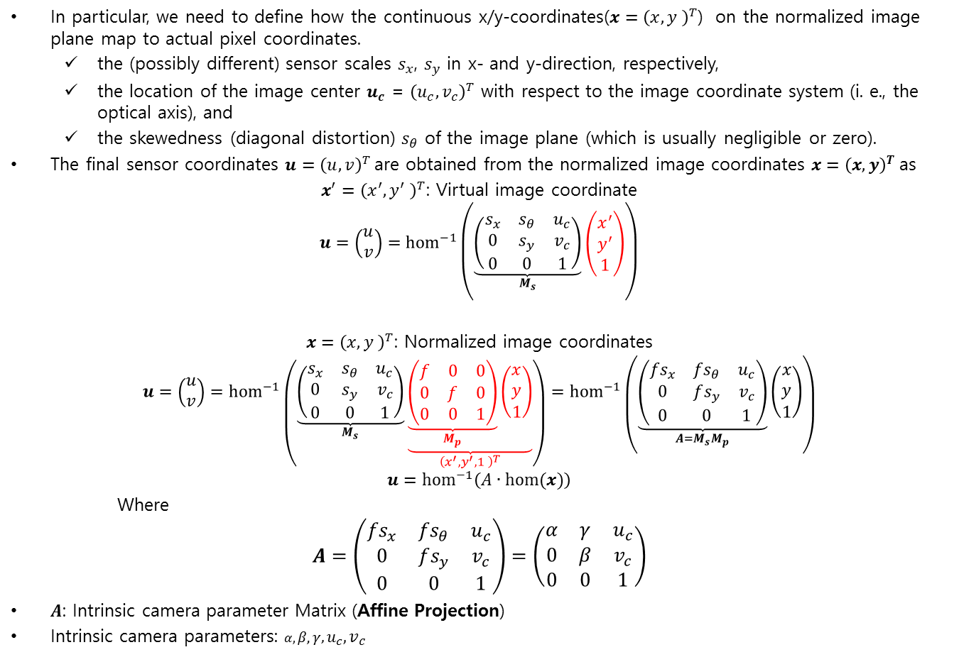
Intrinsic Camera Parameters
In particular, we need to define how the continuous x/y-coordinates($x={\left(x,y \right)}^{T}$) on the normalized image plane map to actual pixel coordinates.
the (possibly different) sensor scales $s_{x}$, $s_{y}$ in x- and y-direction, respectively,
the location of the image center $u_{c}$ = ${\left(u_{c},v_{c}\right)}^{T}$ with respect to the image coordinate system (i. e., the optical axis), and
the skewedness (diagonal distortion) $s_{θ}$ of the image plane (which is usually negligible or zero).
The final sensor coordinates $u={\left(u,v\right)}^{T}$are obtained from the normalized image coordinates $x={\left(x,y\right)}^{T}$as
$x_{}^{′}={\left(x^{′},y^{′} \right)}^{T}$: Virtual image coordinate
$$u=\left(\begin{matrix}u \\ v\end{matrix}\right)={hom}^{−1}\left(\underset{M_{s}}{\underbrace{\left(\begin{matrix}s_{x} & s_{θ} & u_{c} \\ 0 & s_{y} & v_{c} \\ 0 & 0 & 1\end{matrix}\right)}}\left(\begin{matrix}x^{′} \\ y^{′} \\ 1\end{matrix}\right)\right)$$
$x={\left(x,y \right)}^{T}$: Normalized image coordinates
$$u=\left(\begin{matrix}u \\ v\end{matrix}\right)={hom}^{−1}\left(\underset{M_{s}}{\underbrace{\left(\begin{matrix}s_{x} & s_{θ} & u_{c} \\ 0 & s_{y} & v_{c} \\ 0 & 0 & 1\end{matrix}\right)}}\underset{{\left(x^{′},y^{′},1 \right)}^{T}}{\underbrace{\underset{M_{p}}{\underbrace{\left(\begin{matrix}f & 0 & 0 \\ 0 & f & 0 \\ 0 & 0 & 1\end{matrix}\right)}}\left(\begin{matrix}x \\ y \\ 1\end{matrix}\right)}}\right)={hom}^{−1}\left(\underset{A=M_{s}M_{p}}{\underbrace{\left(\begin{matrix}{fs}_{x} & {fs}_{θ} & u_{c} \\ 0 & fs_{y} & v_{c} \\ 0 & 0 & 1\end{matrix}\right)}}\left(\begin{matrix}x \\ y \\ 1\end{matrix}\right)\right)$$
$$u={hom}^{−1}\left(A∙hom(x)\right)$$
Where
$$A=\left(\begin{matrix}{fs}_{x} & {fs}_{θ} & u_{c} \\ 0 & fs_{y} & v_{c} \\ 0 & 0 & 1\end{matrix}\right)=\left(\begin{matrix}α & γ & u_{c} \\ 0 & β & v_{c} \\ 0 & 0 & 1\end{matrix}\right)$$
$A$: Intrinsic camera parameter Matrix (Affine Projection)
Intrinsic camera parameters: $α,β,γ,u_{c},v_{c}$

Slide 23
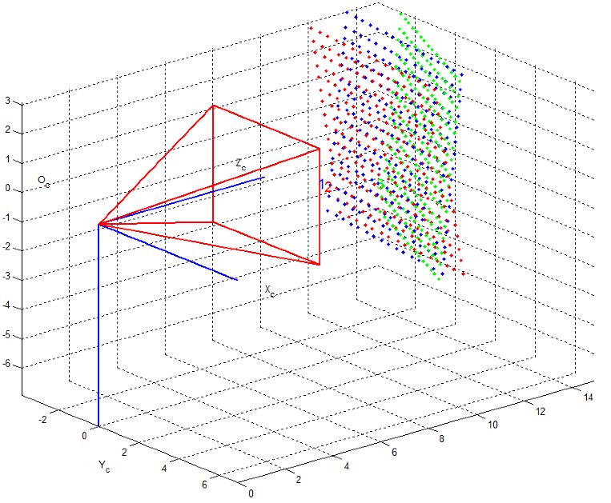
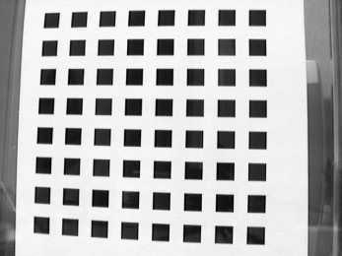
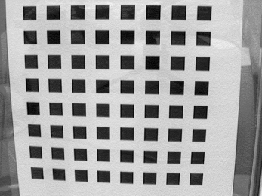
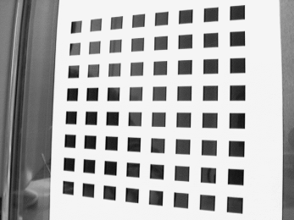




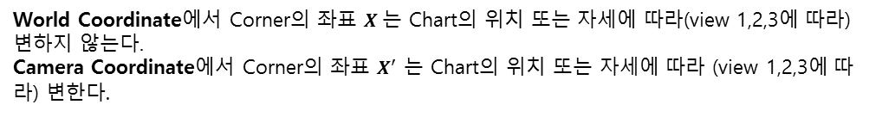


World Coordinate
$X^{′}:$ Camera Coordinate (Cartesian)
$X$ : World Coordinate (Cartesian)
view(Image) 1 2 3
Corners in World Coordinate $X={\left(X,Y,Z=0\right)}^{T}$
Corners in Camera Coordinate $X^{′}$ for each views
$$Z$$
World Coordinate에서 Corner의 좌표 $X$는 Chart의 위치 또는 자세에 따라(view 1,2,3에 따라) 변하지 않는다.
Camera Coordinate에서 Corner의 좌표 $X^{′}$ 는 Chart의 위치 또는 자세에 따라 (view 1,2,3에 따라) 변한다.
$$X$$
$$Y$$

Slide 24




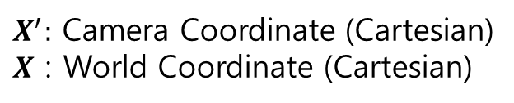



World Coordinate
$X^{′}:$ Camera Coordinate (Cartesian)
$X$ : World Coordinate (Cartesian)
Object on Virtual Image Plane(2D): $x_{}^{′}={\left(x′,y′\right)}^{T}$
Object on Image Plane(2D): $u={\left(u,v\right)}^{T}$
Object in Camera Coordinate:
$X^{′}={\left(X′,Y′,Z′\right)}^{T}$
$$u$$
Pinhole: $X_{o}^{′}={\left(0,0,0\right)}^{T}$
$$X′$$
$$x′$$
$$y$$
$$Z$$
$$Z′$$
Rigid Transformation
Focal length:$f$
Object on Normalized
Image Plane(2D): $x{\left(x,y\right)}^{T}$
$$Y′$$
$$y′$$
1
$$x$$
$$X$$
$$v$$
Pinhole
Virtual Image Plane(2D)
& Image Sensor Plane
Normalized Image Plane(2D)
Rigid Transformation: Transform world coordinate to camera coordinate
Object in world coordinate: $X={\left(X,Y,Z\right)}^{T}$
$$Y$$

Slide 25
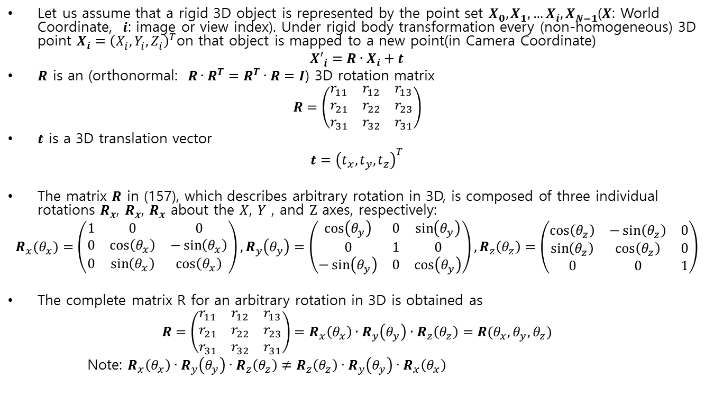
Rigid (body) Transformation
Let us assume that a rigid 3D object is represented by the point set $X_{0}^{},X_{1}^{},…X_{i}^{},X_{N−1}^{}$($X$: World Coordinate, $i$: image or view index). Under rigid body transformation every (non-homogeneous) 3D point $X_{i}^{}={\left(X_{i}^{},Y_{i}^{},Z_{i}^{}\right)}^{T}$on that object is mapped to a new point(in Camera Coordinate)
$${X′}_{i}^{}=R∙X_{i}+t$$
$R$ is an (orthonormal: $R∙R^{T}=R^{T}∙R=I$) 3D rotation matrix
$$R=\left(\begin{matrix}r_{11} & r_{12} & r_{13} \\ r_{21} & r_{22} & r_{23} \\ r_{31} & r_{32} & r_{31}\end{matrix}\right)$$
$t$ is a 3D translation vector
$$t={\left(t_{x},t_{y},t_{z}\right)}^{T}$$
The matrix $R$ in (157), which describes arbitrary rotation in 3D, is composed of three individual rotations $R_{x}$, $R_{x}$, $R_{x}$ about the $X$, $Y$ , and $Z$ axes, respectively:
$$R_{x}(θ_{x})=\left(\begin{matrix}1 & 0 & 0 \\ 0 & \cos\left(θ_{x}\right) & −\sin\left(θ_{x}\right) \\ 0 & \sin\left(θ_{x}\right) & \cos\left(θ_{x}\right)\end{matrix}\right),R_{y}\left(θ_{y}\right)=\left(\begin{matrix}\cos\left(θ_{y}\right) & 0 & \sin\left(θ_{y}\right) \\ 0 & 1 & 0 \\ −\sin\left(θ_{y}\right) & 0 & \cos\left(θ_{y}\right)\end{matrix}\right),R_{z}\left(θ_{z}\right)=\left(\begin{matrix}\cos\left(θ_{z}\right) & −\sin\left(θ_{z}\right) & 0 \\ \sin\left(θ_{z}\right) & \cos\left(θ_{z}\right) & 0 \\ 0 & 0 & 1\end{matrix}\right)$$
The complete matrix R for an arbitrary rotation in 3D is obtained as
$$R=\left(\begin{matrix}r_{11} & r_{12} & r_{13} \\ r_{21} & r_{22} & r_{23} \\ r_{31} & r_{32} & r_{31}\end{matrix}\right)=R_{x}\left(θ_{x}\right)∙R_{y}\left(θ_{y}\right)∙R_{z}\left(θ_{z}\right)=R(θ_{x},θ_{y},θ_{z})$$
Note: $R_{x}\left(θ_{x}\right)∙R_{y}\left(θ_{y}\right)∙R_{z}\left(θ_{z}\right)≠R_{z}\left(θ_{z}\right)∙R_{y}\left(θ_{y}\right)∙R_{x}\left(θ_{x}\right)$

Slide 26

Rigid (body) Transformation
The complete rigid transformation, combining rotation and translation in homogeneous coordinates is then obtained as
$${X′}_{i}^{}=\left(\begin{aligned}{X′}_{i}^{} \\ {Y′}_{i}^{} \\ {Z′}_{i}^{}\end{aligned}\right)=\underset{W}{\underbrace{\left(R | t\right)}}∙hom(X_{i})=W∙hom(X_{i})=\underset{W}{\underbrace{\left(\begin{matrix}r_{11} & r_{12} & r_{13} \\ r_{21} & r_{22} & r_{23} \\ r_{31} & r_{32} & r_{31}\end{matrix} \begin{matrix}t_{x} \\ t_{y} \\ t_{z}\end{matrix}\right)}}∙\left(\begin{aligned}X_{i}^{} \\ Y_{i}^{} \\ Z_{i}^{} \\ 1\end{aligned}\right)$$
${X′}_{i}^{}$: Corner Point Set of $i$th view in Camera Coordinate
$X_{i}^{}$: Corner Point Set of $i$th view in World Coordinate

Slide 27
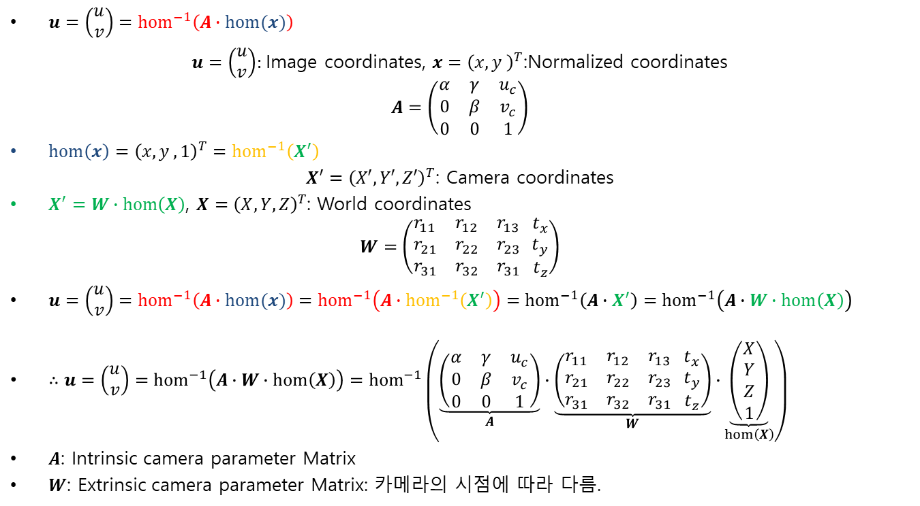
Extrinsic Camera Parameters
$u=\left(\begin{matrix}u \\ v\end{matrix}\right)={hom}^{−1}\left(A∙hom(x)\right)$
$u=\left(\begin{matrix}u \\ v\end{matrix}\right)$: Image coordinates, $x={\left(x,y \right)}^{T}$:Normalized coordinates
$$A=\left(\begin{matrix}α & γ & u_{c} \\ 0 & β & v_{c} \\ 0 & 0 & 1\end{matrix}\right)$$
$hom\left(x\right)={\left(x,y ,1\right)}^{T}={hom}^{−1}\left(X^{′}\right)$
$X^{′}={\left(X′,Y′,Z′\right)}^{T}$: Camera coordinates
$X^{′}=W∙hom\left(X\right)$, $X={\left(X,Y,Z\right)}^{T}$: World coordinates
$$W=\left(\begin{matrix}r_{11} & r_{12} & r_{13} \\ r_{21} & r_{22} & r_{23} \\ r_{31} & r_{32} & r_{31}\end{matrix} \begin{matrix}t_{x} \\ t_{y} \\ t_{z}\end{matrix}\right)$$
$u=\left(\begin{matrix}u \\ v\end{matrix}\right)={hom}^{−1}\left(A∙hom(x)\right)={hom}^{−1}\left(A∙{hom}^{−1}\left(X^{′}\right)\right)={hom}^{−1}\left(A∙X^{′}\right)={hom}^{−1}\left(A∙W∙hom\left(X\right)\right)$
$∴u=\left(\begin{matrix}u \\ v\end{matrix}\right)={hom}^{−1}\left(A∙W∙hom\left(X\right)\right)={hom}^{−1}\left(\underset{A}{\underbrace{\left(\begin{matrix}α & γ & u_{c} \\ 0 & β & v_{c} \\ 0 & 0 & 1\end{matrix}\right)}}∙\underset{W}{\underbrace{\left(\begin{matrix}r_{11} & r_{12} & r_{13} \\ r_{21} & r_{22} & r_{23} \\ r_{31} & r_{32} & r_{31}\end{matrix} \begin{matrix}t_{x} \\ t_{y} \\ t_{z}\end{matrix}\right)}}∙\underset{hom\left(X\right)}{\underbrace{\left(\begin{aligned}X \\ Y \\ Z \\ 1\end{aligned}\right)}}\right)$
$A$: Intrinsic camera parameter Matrix
$W$: Extrinsic camera parameter Matrix: 카메라의 시점에 따라 다름.

Slide 28








Rodrigues Rotation Formula (Rodrigues vector to Rotation matrix.)
Given a 3D rotation specified by the Rodrigues vector $ρ ={\left(ρ_{x},ρ_{y},ρ_{z}\right)}^{T}$, the corresponding rotation matrix $R$ can be found as follows. First, we extract the rotation angle $θ$ (with $\left|θ\right|<π$) and the unit direction vector $\hat{ρ}$ by
$θ=\left\|ρ\right\|$ and $\hat{ρ}={\left(\hat{ρ_{x}},\hat{ρ_{y}},\hat{ρ_{z}}\right)}^{T}=\frac{ρ}{\left\|ρ\right\|}=\frac{ρ}{θ}$, $\left\|\hat{ρ}\right\|=1$
$$Z$$
$$\hat{ρ}={\left(\hat{ρ_{x}},\hat{ρ_{y}},\hat{ρ_{z}}\right)}^{T}$$
$$X$$
$$θ$$
$$X′$$
$$X$$
$$Y$$

Slide 29
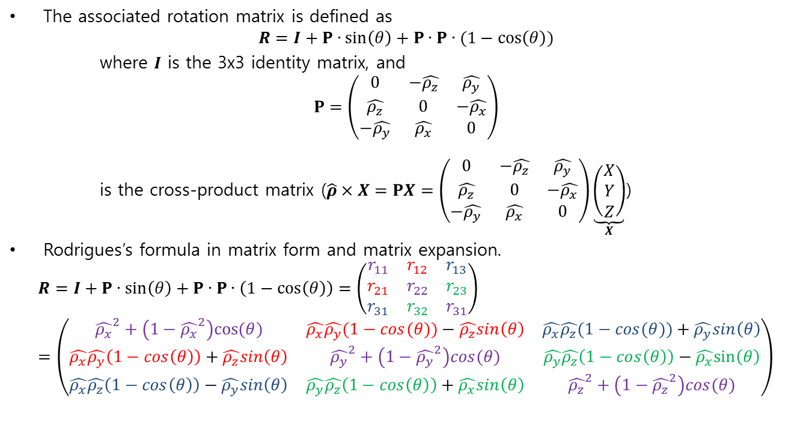
Rodrigues Rotation Formula (Rodrigues vector to Rotation matrix.)
The associated rotation matrix is defined as
$$R=I+Ρ∙sin\left(θ\right)+Ρ∙Ρ∙(1−\cos\left(θ\right))$$
where $I$ is the 3x3 identity matrix, and
$$Ρ=\left(\begin{matrix}0 & −\hat{ρ_{z}} & \hat{ρ_{y}} \\ \hat{ρ_{z}} & 0 & −\hat{ρ_{x}} \\ −\hat{ρ_{y}} & \hat{ρ_{x}} & 0\end{matrix}\right)$$
is the cross-product matrix ($\hat{ρ}×X=ΡX=\left(\begin{matrix}0 & −\hat{ρ_{z}} & \hat{ρ_{y}} \\ \hat{ρ_{z}} & 0 & −\hat{ρ_{x}} \\ −\hat{ρ_{y}} & \hat{ρ_{x}} & 0\end{matrix}\right)\underset{X}{\underbrace{\left(\begin{aligned}X \\ Y \\ Z\end{aligned}\right)}}$)
Rodrigues’s formula in matrix form and matrix expansion.
$$R=I+Ρ∙sin\left(θ\right)+Ρ∙Ρ∙\left(1−\cos\left(θ\right)\right)=\left(\begin{matrix}r_{11} & r_{12} & r_{13} \\ r_{21} & r_{22} & r_{23} \\ r_{31} & r_{32} & r_{31}\end{matrix}\right)=\left(\begin{matrix}{\hat{ρ_{x}}}^{2}+\left(1−{\hat{ρ_{x}}}^{2}\right)cos⁡(θ) & \hat{ρ_{x}}\hat{ρ_{y}}(1−cos⁡(θ))−\hat{ρ_{z}}sin\left(θ\right) & \hat{ρ_{x}}\hat{ρ_{z}}(1−cos⁡(θ))+\hat{ρ_{y}}sin\left(θ\right) \\ \hat{ρ_{x}}\hat{ρ_{y}}\left(1−\cos\left(θ\right)\right)+\hat{ρ_{z}}sin\left(θ\right) & {\hat{ρ_{y}}}^{2}+\left(1−{\hat{ρ_{y}}}^{2}\right)cos⁡(θ) & \hat{ρ_{y}}\hat{ρ_{z}}\left(1−\cos\left(θ\right)\right)−\hat{ρ_{x}}sin\left(θ\right) \\ \hat{ρ_{x}}\hat{ρ_{z}}\left(1−\cos\left(θ\right)\right)−\hat{ρ_{y}}sin\left(θ\right) & \hat{ρ_{y}}\hat{ρ_{z}}\left(1−\cos\left(θ\right)\right)+\hat{ρ_{x}}sin\left(θ\right) & {\hat{ρ_{z}}}^{2}+\left(1−{\hat{ρ_{z}}}^{2}\right)cos⁡(θ)\end{matrix}\right)$$

Slide 30
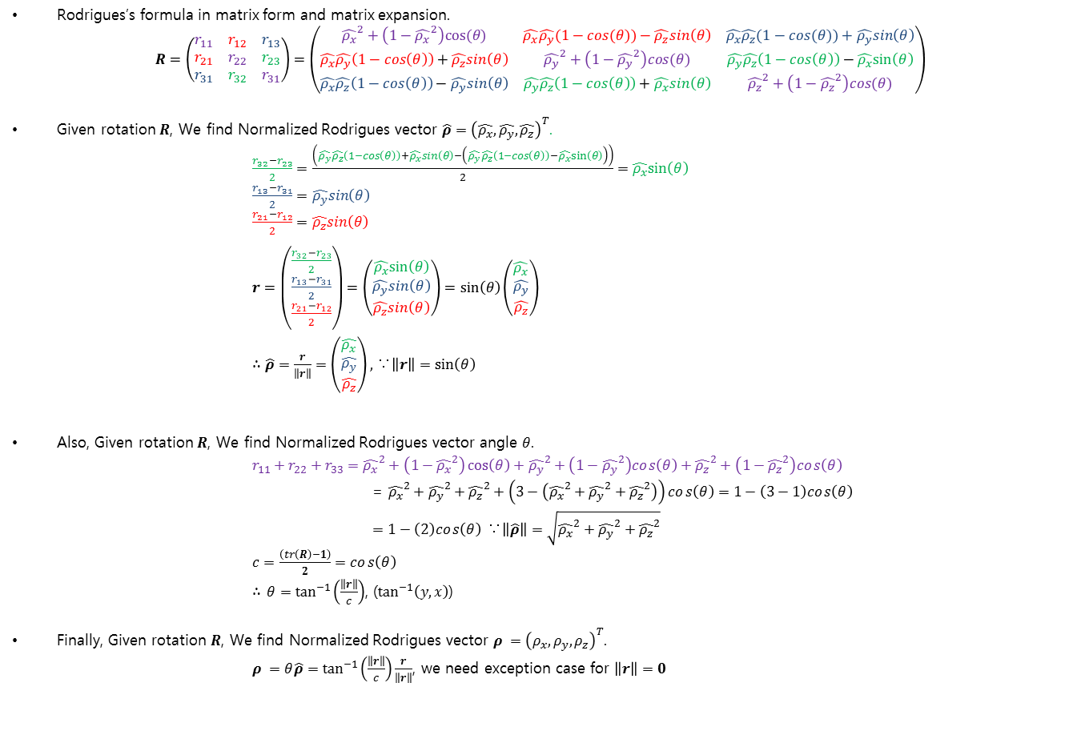
Rodrigues Rotation Formula (Rotation matrix to Rodrigues vector)
Rodrigues’s formula in matrix form and matrix expansion.
$$R=\left(\begin{matrix}r_{11} & r_{12} & r_{13} \\ r_{21} & r_{22} & r_{23} \\ r_{31} & r_{32} & r_{31}\end{matrix}\right)=\left(\begin{matrix}{\hat{ρ_{x}}}^{2}+\left(1−{\hat{ρ_{x}}}^{2}\right)cos⁡(θ) & \hat{ρ_{x}}\hat{ρ_{y}}(1−cos⁡(θ))−\hat{ρ_{z}}sin\left(θ\right) & \hat{ρ_{x}}\hat{ρ_{z}}(1−cos⁡(θ))+\hat{ρ_{y}}sin\left(θ\right) \\ \hat{ρ_{x}}\hat{ρ_{y}}\left(1−\cos\left(θ\right)\right)+\hat{ρ_{z}}sin\left(θ\right) & {\hat{ρ_{y}}}^{2}+\left(1−{\hat{ρ_{y}}}^{2}\right)cos⁡(θ) & \hat{ρ_{y}}\hat{ρ_{z}}\left(1−\cos\left(θ\right)\right)−\hat{ρ_{x}}sin\left(θ\right) \\ \hat{ρ_{x}}\hat{ρ_{z}}\left(1−\cos\left(θ\right)\right)−\hat{ρ_{y}}sin\left(θ\right) & \hat{ρ_{y}}\hat{ρ_{z}}\left(1−\cos\left(θ\right)\right)+\hat{ρ_{x}}sin\left(θ\right) & {\hat{ρ_{z}}}^{2}+\left(1−{\hat{ρ_{z}}}^{2}\right)cos⁡(θ)\end{matrix}\right)$$
Given rotation $R$, We find Normalized Rodrigues vector $\hat{ρ}={\left(\hat{ρ_{x}},\hat{ρ_{y}},\hat{ρ_{z}}\right)}^{T}$.
$\frac{r_{32}−r_{23}}{2}=\frac{\left(\hat{ρ_{y}}\hat{ρ_{z}}\left(1−\cos\left(θ\right)\right)+\hat{ρ_{x}}sin\left(θ\right)−\left(\hat{ρ_{y}}\hat{ρ_{z}}\left(1−\cos\left(θ\right)\right)−\hat{ρ_{x}}sin\left(θ\right)\right)\right)}{2}=\hat{ρ_{x}}sin\left(θ\right)$
$\frac{r_{13}−r_{31}}{2}=\hat{ρ_{y}}sin\left(θ\right)$
$\frac{r_{21}−r_{12}}{2}=\hat{ρ_{z}}sin\left(θ\right)$
$r=\left(\begin{aligned}\frac{r_{32}−r_{23}}{2} \\ \frac{r_{13}−r_{31}}{2} \\ \frac{r_{21}−r_{12}}{2}\end{aligned}\right)=\left(\begin{aligned}\hat{ρ_{x}}sin\left(θ\right) \\ \hat{ρ_{y}}sin\left(θ\right) \\ \hat{ρ_{z}}sin\left(θ\right)\end{aligned}\right)=sin\left(θ\right)\left(\begin{aligned}\hat{ρ_{x}} \\ \hat{ρ_{y}} \\ \hat{ρ_{z}}\end{aligned}\right)$
$∴\hat{ρ}=\frac{r}{\left\|r\right\|}=\left(\begin{aligned}\hat{ρ_{x}} \\ \hat{ρ_{y}} \\ \hat{ρ_{z}}\end{aligned}\right)\text{, }\text{∵}\left\|r\right\|=sin\left(θ\right)$
Also, Given rotation $R$, We find Normalized Rodrigues vector angle $θ$.
$r_{11}+r_{22}+r_{33}={\hat{ρ_{x}}}^{2}+\left(1−{\hat{ρ_{x}}}^{2}\right)\cos\left(θ\right)+{\hat{ρ_{y}}}^{2}+\left(1−{\hat{ρ_{y}}}^{2}\right)cos\left(θ\right)+{\hat{ρ_{z}}}^{2}+\left(1−{\hat{ρ_{z}}}^{2}\right)cos\left(θ\right)$
= ${\hat{ρ_{x}}}^{2}+{\hat{ρ_{y}}}^{2}+{\hat{ρ_{z}}}^{2}+\left(3−\left({\hat{ρ_{x}}}^{2}+{\hat{ρ_{y}}}^{2}+{\hat{ρ_{z}}}^{2}\right)\right)cos\left(θ\right)=1−\left(3−1\right)cos\left(θ\right)$
$=1−\left(2\right)cos\left(θ\right)$ $\text{∵}\left\|\hat{ρ}\right\|=\sqrt{{\hat{ρ_{x}}}^{2}+{\hat{ρ_{y}}}^{2}+{\hat{ρ_{z}}}^{2}}$
$c=\frac{\left(tr\left(R\right)−1\right)}{2}=cos\left(θ\right)$
$∴$ $θ=\tan^{−1}\left(\frac{\left\|r\right\|}{c}\right)$, ($\tan^{−1}\left(y,x\right)$)
Finally, Given rotation $R$, We find Normalized Rodrigues vector $ρ ={\left(ρ_{x},ρ_{y},ρ_{z}\right)}^{T}$.
$ρ =θ\hat{ρ}=\tan^{−1}\left(\frac{\left\|r\right\|}{c}\right)\frac{r}{\left\|r\right\|}$, we need exception case for $\left\|r\right\|=0$

Slide 31







Pinhole Camera Parameters
$u=\left(\begin{matrix}u \\ v\end{matrix}\right)={hom}^{−1}\left(A∙W∙hom\left(X\right)\right)={hom}^{−1}\left(\underset{A}{\underbrace{\left(\begin{matrix}α & γ & u_{c} \\ 0 & β & v_{c} \\ 0 & 0 & 1\end{matrix}\right)}}∙\underset{W=\left(R | t\right)}{\underbrace{\left(\begin{matrix}r_{11} & r_{12} & r_{13} \\ r_{21} & r_{22} & r_{23} \\ r_{31} & r_{32} & r_{31}\end{matrix} \begin{matrix}t_{x} \\ t_{y} \\ t_{z}\end{matrix}\right)}}∙\underset{hom\left(X\right)}{\underbrace{\left(\begin{aligned}X \\ Y \\ Z \\ 1\end{aligned}\right)}}\right)$
$A$: Intrinsic camera parameter Matrix, Intrinsic camera parameters: ($α,β,γ,u_{c},v_{c}$)
$W$: Extrinsic camera parameter Matrix ($ρ ={\left(ρ_{x},ρ_{y},ρ_{z}\right)}^{T} →R$), Extrinsic camera parameters: ($ρ_{x},ρ_{y},ρ_{z},t_{x},t_{y},t_{z}$)
Object on Virtual Image Plane(2D): $x_{}^{′}={\left(x′,y′\right)}^{T}$
Object on Image Plane(2D): $u={\left(u,v\right)}^{T}$
Object in Camera Coordinate:
$X^{′}={\left(X′,Y′,Z′\right)}^{T}$
$$u$$
Pinhole: $X_{o}^{′}={\left(0,0,0\right)}^{T}$
$$X′$$
$$x′$$
$$y$$
$$Z$$
$$Z′$$
Rigid Transformation
Focal length:$f$
Object on Normalized
Image Plane(2D): $x{\left(x,y\right)}^{T}$
$$Y′$$
$$y′$$
1
$$x$$
$$X$$
$$v$$
Pinhole
Virtual Image Plane(2D)
& Image Sensor Plane
Normalized Image Plane(2D)
Object in world coordinate: $X={\left(X,Y,Z\right)}^{T}$
$$Y$$

Slide 32
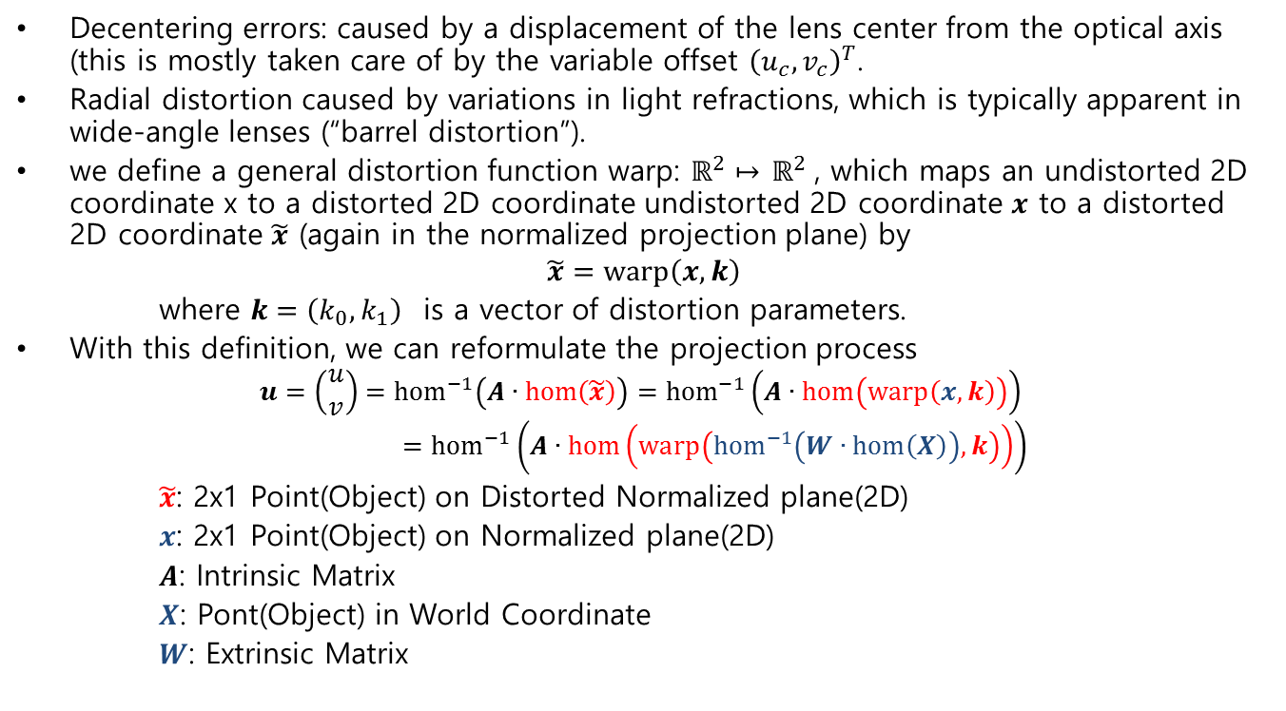
Lens Distortion
Decentering errors: caused by a displacement of the lens center from the optical axis (this is mostly taken care of by the variable offset ${\left(u_{c},v_{c}\right)}^{T}$.
Radial distortion caused by variations in light refractions, which is typically apparent in wide-angle lenses (“barrel distortion”).
we define a general distortion function warp: $ℝ^{2}↦$ $ℝ^{2}$, which maps an undistorted 2D coordinate x to a distorted 2D coordinate undistorted 2D coordinate $x$ to a distorted 2D coordinate $\tilde{x}$ (again in the normalized projection plane) by
$$\tilde{x}=warp\left(x,k\right)$$
where $k=\left(k_{0},k_{1}\right)$ is a vector of distortion parameters.
With this definition, we can reformulate the projection process
$$u=\left(\begin{matrix}u \\ v\end{matrix}\right)={hom}^{−1}\left(A∙hom\left(\tilde{x}\right)\right)={hom}^{−1}\left(A∙hom\left(warp\left(x,k\right)\right)\right)={hom}^{−1}\left(A∙hom\left(warp\left({hom}^{−1}\left(W∙hom\left(X\right)\right),k\right)\right)\right)$$
$\tilde{x}$: 2x1 Point(Object) on Distorted Normalized plane(2D)
$x$: 2x1 Point(Object) on Normalized plane(2D)
$A$: Intrinsic Matrix
$X$: Pont(Object) in World Coordinate
$W$: Extrinsic Matrix

Slide 33







Lens Distortion (Radial distortion model)
$$\tilde{x}$$
$$\tilde{r}=\left\|\tilde{x}\right\|$$
$$x$$
$$r=\left\|x\right\|$$
$$x$$
Normalized Plane(2D)
$$v$$
Pinhole: $x_{c}^{}={\left(0,0\right)}^{T}$
$$y$$

Slide 34
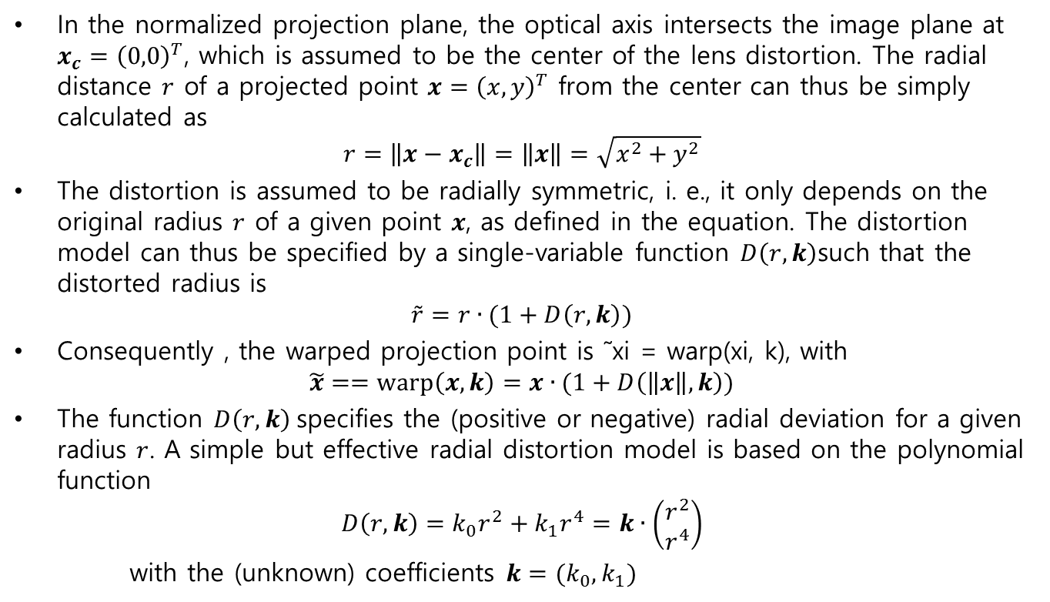
Lens Distortion (Radial distortion model)
In the normalized projection plane, the optical axis intersects the image plane at $x_{c}^{}={\left(0,0\right)}^{T}$, which is assumed to be the center of the lens distortion. The radial distance $r$ of a projected point $x={\left(x,y\right)}^{T}$ from the center can thus be simply calculated as
$$r=\left\|x−x_{c}^{}\right\|=\left\|x\right\|=\sqrt{x^{2}+y^{2}}$$
The distortion is assumed to be radially symmetric, i. e., it only depends on the original radius $r$ of a given point $x$, as defined in the equation. The distortion model can thus be specified by a single-variable function $D\left(r,k\right)$such that the distorted radius is
$$\tilde{r}=r∙(1+D\left(r,k\right))$$
Consequently , the warped projection point is ˜xi = warp(xi, k), with
$$\tilde{x}==warp\left(x,k\right)=x∙(1+D\left(\left\|x\right\|,k\right))$$
The function $D\left(r,k\right)$specifies the (positive or negative) radial deviation for a given radius $r$. A simple but effective radial distortion model is based on the polynomial function
$$D\left(r,k\right)=k_{0}r^{2}+k_{1}r^{4}=k∙\left(\begin{aligned}r^{2} \\ r^{4}\end{aligned}\right)$$
with the (unknown) coefficients $k=(k_{0},k_{1})$

Slide 35
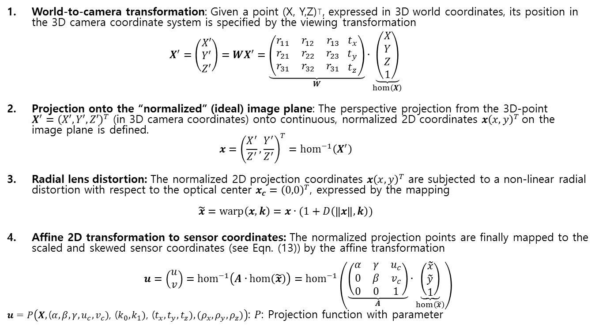
Summary of the projection process
World-to-camera transformation: Given a point (X, Y,Z)⊺, expressed in 3D world coordinates, its position in the 3D camera coordinate system is specified by the viewing transformation $X^{′}=\left(\begin{aligned}X′ \\ Y′ \\ Z′\end{aligned}\right)=WX^{′}=\underset{W}{\underbrace{\left(\begin{matrix}r_{11} & r_{12} & r_{13} \\ r_{21} & r_{22} & r_{23} \\ r_{31} & r_{32} & r_{31}\end{matrix} \begin{matrix}t_{x} \\ t_{y} \\ t_{z}\end{matrix}\right)}}∙\underset{hom\left(X\right)}{\underbrace{\left(\begin{aligned}X \\ Y \\ Z \\ 1\end{aligned}\right)}}$
Projection onto the “normalized” (ideal) image plane: The perspective projection from the 3D-point $X^{′}={\left(X′,Y′,Z′\right)}^{T}$ (in 3D camera coordinates) onto continuous, normalized 2D coordinates $x{\left(x,y\right)}^{T}$on the image plane is defined. $x={\left(\frac{X^{′}}{Z^{′}},\frac{Y^{′}}{Z^{′}}\right)}^{T}={hom}^{−1}\left(X^{′}\right)$
Radial lens distortion: The normalized 2D projection coordinates $x{\left(x,y\right)}^{T}$ are subjected to a non-linear radial distortion with respect to the optical center $x_{c}^{}={\left(0,0\right)}^{T}$, expressed by the mapping $\tilde{x}=warp\left(x,k\right)=x∙(1+D\left(\left\|x\right\|,k\right))$
Affine 2D transformation to sensor coordinates: The normalized projection points are finally mapped to the scaled and skewed sensor coordinates (see Eqn. (13)) by the affine transformation
$$u=\left(\begin{matrix}u \\ v\end{matrix}\right)={hom}^{−1}\left(A∙hom\left(\tilde{x}\right)\right)={hom}^{−1}\left(\underset{A}{\underbrace{\left(\begin{matrix}α & γ & u_{c} \\ 0 & β & v_{c} \\ 0 & 0 & 1\end{matrix}\right)}}∙\underset{hom\left(\tilde{x}\right)}{\underbrace{\left(\begin{matrix}\tilde{x} \\ \tilde{y} \\ 1\end{matrix}\right)}}\right)$$
$u=P\left(X,\text{(}α,β,γ,u_{c},v_{c})\text{, (}k_{0},k_{1})\text{,}\text{ (}t_{x},t_{y},t_{z}),(ρ_{x},ρ_{y},ρ_{z})\right)$: $P$: Projection function with parameter

Slide 36
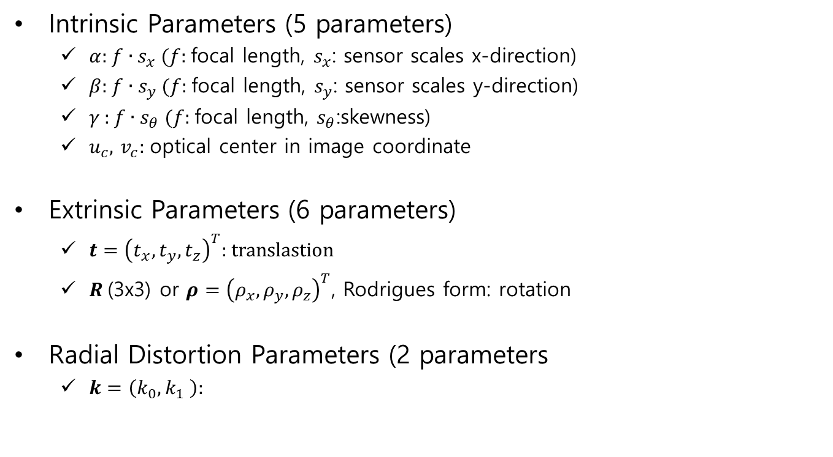
Camera Calibration
Intrinsic Parameters (5 parameters)
$α$: $f∙s_{x}$ ($f$: focal length, $s_{x}$: sensor scales x-direction)
$β$: $f∙s_{y}$ ($f$: focal length, $s_{y}$: sensor scales y-direction)
$γ$ : $f∙s_{θ}$ ($f$: focal length, $s_{θ}$:skewness)
$u_{c}$, $v_{c}$: optical center in image coordinate
Extrinsic Parameters (6 parameters)
$t={\left(t_{x},t_{y},t_{z}\right)}^{T}$: translastion
$R$(3x3) or $ρ={\left(ρ_{x},ρ_{y},ρ_{z}\right)}^{T}$, Rodrigues form: rotation
Radial Distortion Parameters (2 parameters
$k=\left(k_{0},k_{1} \right)$:

Slide 37
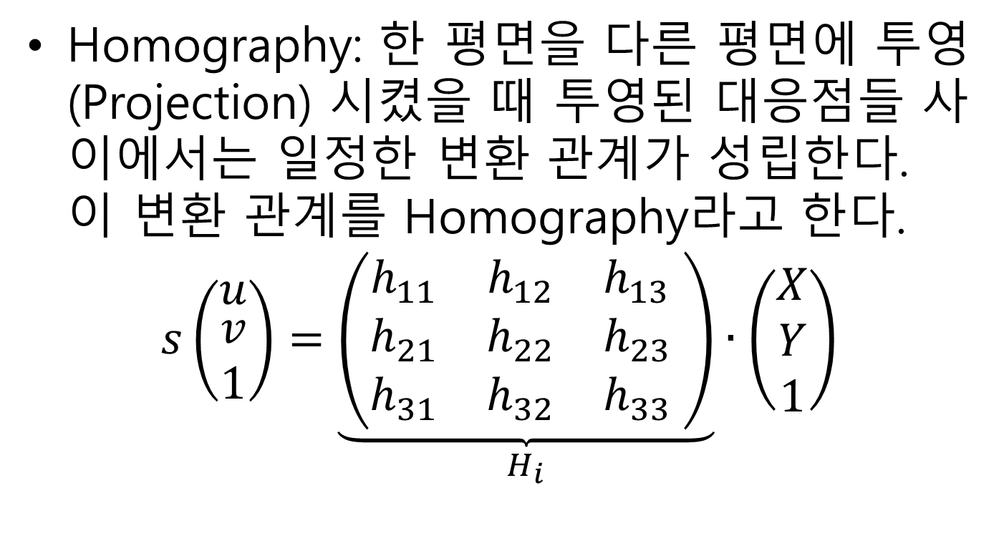
Homography
Homography: 한 평면을 다른 평면에 투영(Projection) 시켰을 때 투영된 대응점들 사이에서는 일정한 변환 관계가 성립한다. 이 변환 관계를 Homography라고 한다.
$$s\left(\begin{matrix}u \\ \begin{aligned}v \\ 1\end{aligned}\end{matrix}\right)=\underset{H_{i}}{\underbrace{\left(\begin{matrix}h_{11} & h_{12} & h_{13} \\ h_{21} & h_{22} & h_{23} \\ h_{31} & h_{32} & h_{33}\end{matrix} \right)}}∙\left(\begin{aligned}X \\ Y \\ 1\end{aligned}\right)$$

Slide 38
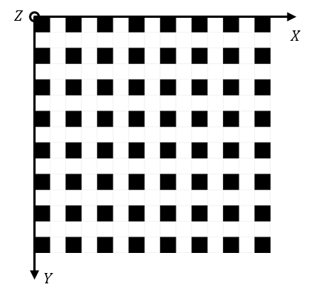
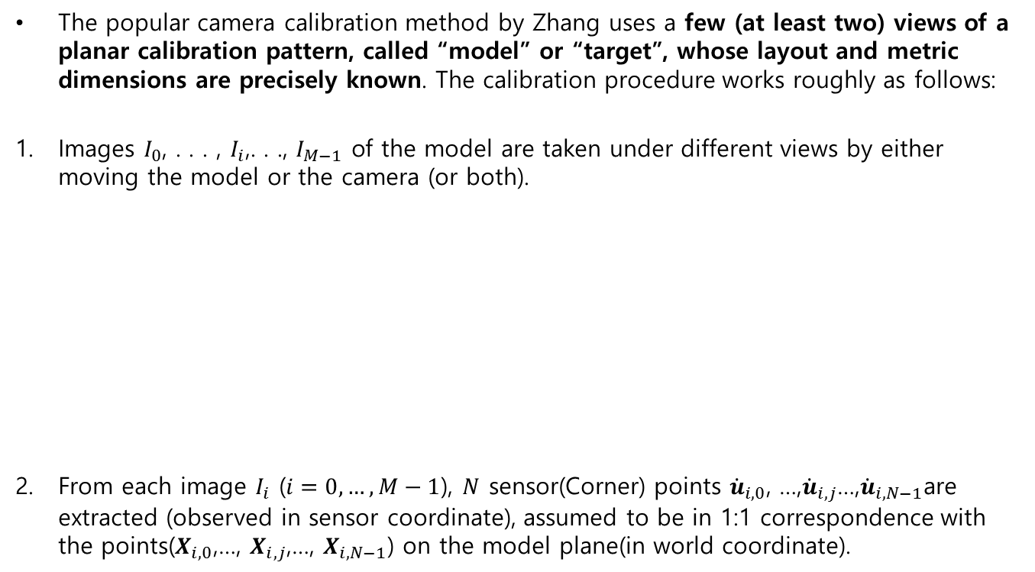
Plane-based “self” calibration
The popular camera calibration method by Zhang uses a few (at least two) views of a planar calibration pattern, called “model” or “target”, whose layout and metric dimensions are precisely known. The calibration procedure works roughly as follows:
Images $I_{0}$, . . . , $I_{i}$,. . ., $I_{M−1}$ of the model are taken under different views by either moving the model or the camera (or both).
From each image $I_{i}$ ($i=0,…,M−1$), $N$ sensor(Corner) points ${\dot{u}}_{i,0}$, …,${\dot{u}}_{i,j}$…,${\dot{u}}_{i,N−1}$are extracted (observed in sensor coordinate), assumed to be in 1:1 correspondence with the points($X_{i,0}$,…, $X_{i,j}$,…, $X_{i,N−1}$) on the model plane(in world coordinate).
images
Model in world coordinate

Slide 39
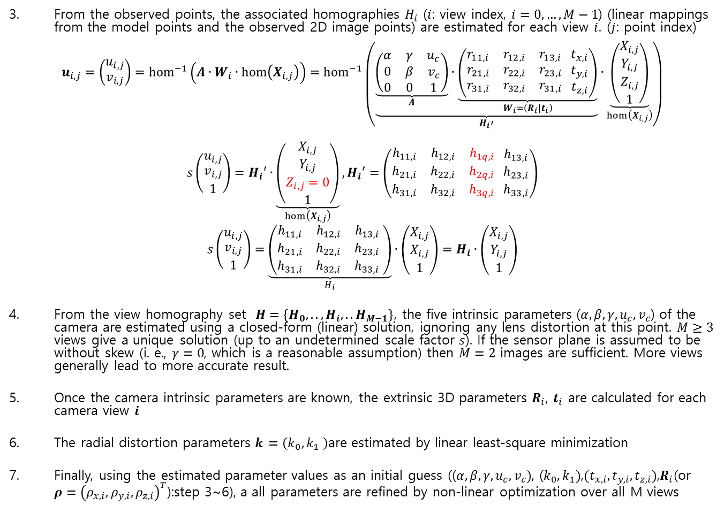
Plane-based “self” calibration
From the observed points, the associated homographies $H_{i}$ ($i$: view index, $i=0,…,M−1$) (linear mappings from the model points and the observed 2D image points) are estimated for each view $i$. ($j$: point index)
$u_{i,j}=\left(\begin{matrix}u_{i,j} \\ v_{i,j}\end{matrix}\right)={hom}^{−1}\left(A∙W_{i}∙hom\left(X_{i,j}\right)\right)={hom}^{−1}\left(\underset{H_{i}′}{\underbrace{\underset{A}{\underbrace{\left(\begin{matrix}α & γ & u_{c} \\ 0 & β & v_{c} \\ 0 & 0 & 1\end{matrix}\right)}}∙\underset{W_{i}=\left(R_{i}|t_{i}\right)}{\underbrace{\left(\begin{matrix}r_{11,i} & r_{12,i} & r_{13,i} \\ r_{21,i} & r_{22,i} & r_{23,i} \\ r_{31,i} & r_{32,i} & r_{31,i}\end{matrix} \begin{matrix}t_{x,i} \\ t_{y,i} \\ t_{z,i}\end{matrix}\right)}}}}∙\underset{hom\left(X_{i,j}\right)}{\underbrace{\left(\begin{aligned}X_{i,j} \\ Y_{i,j} \\ Z_{i,j} \\ 1\end{aligned}\right)}}\right)$
$$s\left(\begin{matrix}u_{i,j} \\ \begin{aligned}v_{i,j} \\ 1\end{aligned}\end{matrix}\right)=H_{i}′∙\underset{hom\left(X_{i,j}\right)}{\underbrace{\left(\begin{aligned}X_{i,j} \\ Y_{i,j} \\ Z_{i,j}=0 \\ 1\end{aligned}\right)}},H_{i}′=\left(\begin{matrix}h_{11,i} & h_{12,i} & h_{1q,i} \\ h_{21,i} & h_{22,i} & h_{2q,i} \\ h_{31,i} & h_{32,i} & h_{3q,i}\end{matrix} \begin{matrix}h_{13,i} \\ h_{23,i} \\ h_{33,i}\end{matrix}\right)$$
$$s\left(\begin{matrix}u_{i,j} \\ \begin{aligned}v_{i,j} \\ 1\end{aligned}\end{matrix}\right)=\underset{H_{i}}{\underbrace{\left(\begin{matrix}h_{11,i} & h_{12,i} & h_{13,i} \\ h_{21,i} & h_{22,i} & h_{23,i} \\ h_{31,i} & h_{32,i} & h_{33,i}\end{matrix} \right)}}∙\left(\begin{aligned}X_{i,j} \\ X_{i,j} \\ 1\end{aligned}\right)=H_{i}∙\left(\begin{aligned}X_{i,j} \\ Y_{i,j} \\ 1\end{aligned}\right)$$
From the view homography set $Η=\left\{H_{0},..,H_{i},..H_{M−1}\right\}$, the five intrinsic parameters ($α,β,γ,u_{c},v_{c}$) of the camera are estimated using a closed-form (linear) solution, ignoring any lens distortion at this point. $M≥3$ views give a unique solution (up to an undetermined scale factor $s$). If the sensor plane is assumed to be without skew (i. e., $γ=0$, which is a reasonable assumption) then $M=2$ images are sufficient. More views generally lead to more accurate result.
Once the camera intrinsic parameters are known, the extrinsic 3D parameters $R_{i}$, $t_{i}$ are calculated for each camera view 𝒊
The radial distortion parameters 𝒌 $=\left(k_{0},k_{1} \right)$are estimated by linear least-square minimization
Finally, using the estimated parameter values as an initial guess (($α,β,γ,u_{c},v_{c})$, ($k_{0},k_{1})$,$(t_{x,i},t_{y,i},t_{z,i})$,$R_{i}$(or $ρ={\left(ρ_{x,i},ρ_{y,i},ρ_{z,i}\right)}^{T}$):step 3~6), a all parameters are refined by non-linear optimization over all M views

Slide 40
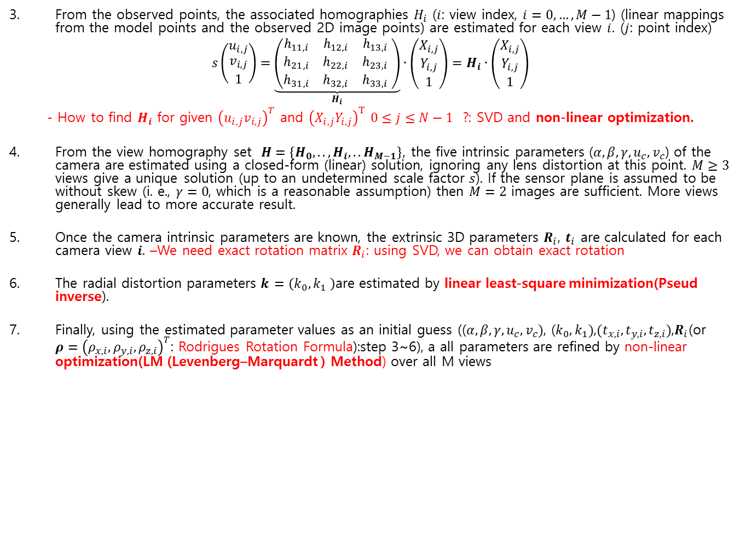
Plane-based “self” calibration
From the observed points, the associated homographies $H_{i}$ ($i$: view index, $i=0,…,M−1$) (linear mappings from the model points and the observed 2D image points) are estimated for each view $i$. ($j$: point index)
$$s\left(\begin{matrix}u_{i,j} \\ \begin{aligned}v_{i,j} \\ 1\end{aligned}\end{matrix}\right)=\underset{H_{i}}{\underbrace{\left(\begin{matrix}h_{11,i} & h_{12,i} & h_{13,i} \\ h_{21,i} & h_{22,i} & h_{23,i} \\ h_{31,i} & h_{32,i} & h_{33,i}\end{matrix} \right)}}∙\left(\begin{aligned}X_{i,j} \\ Y_{i,j} \\ 1\end{aligned}\right)=H_{i}∙\left(\begin{aligned}X_{i,j} \\ Y_{i,j} \\ 1\end{aligned}\right)$$
- How to find $H_{i}$ for given ${\left(u_{i,j}v_{i,j}\right)}^{T}$ and ${\left(X_{i,j}Y_{i,j}\right)}^{T}$ $0≤j≤N−1$ ?: SVD and non-linear optimization.
From the view homography set $Η=\left\{H_{0},..,H_{i},..H_{M−1}\right\}$, the five intrinsic parameters ($α,β,γ,u_{c},v_{c}$) of the camera are estimated using a closed-form (linear) solution, ignoring any lens distortion at this point. $M≥3$ views give a unique solution (up to an undetermined scale factor $s$). If the sensor plane is assumed to be without skew (i. e., $γ=0$, which is a reasonable assumption) then $M=2$ images are sufficient. More views generally lead to more accurate result.
Once the camera intrinsic parameters are known, the extrinsic 3D parameters $R_{i}$, $t_{i}$ are calculated for each camera view 𝒊. –We need exact rotation matrix $R_{i}$: using SVD, we can obtain exact rotation
The radial distortion parameters 𝒌 $=\left(k_{0},k_{1} \right)$are estimated by linear least-square minimization(Pseud inverse).
Finally, using the estimated parameter values as an initial guess (($α,β,γ,u_{c},v_{c})$, ($k_{0},k_{1})$,$(t_{x,i},t_{y,i},t_{z,i})$,$R_{i}$(or $ρ={\left(ρ_{x,i},ρ_{y,i},ρ_{z,i}\right)}^{T}$: Rodrigues Rotation Formula):step 3~6), a all parameters are refined by non-linear optimization(LM (Levenberg–Marquardt ) Method) over all M views

Slide 41
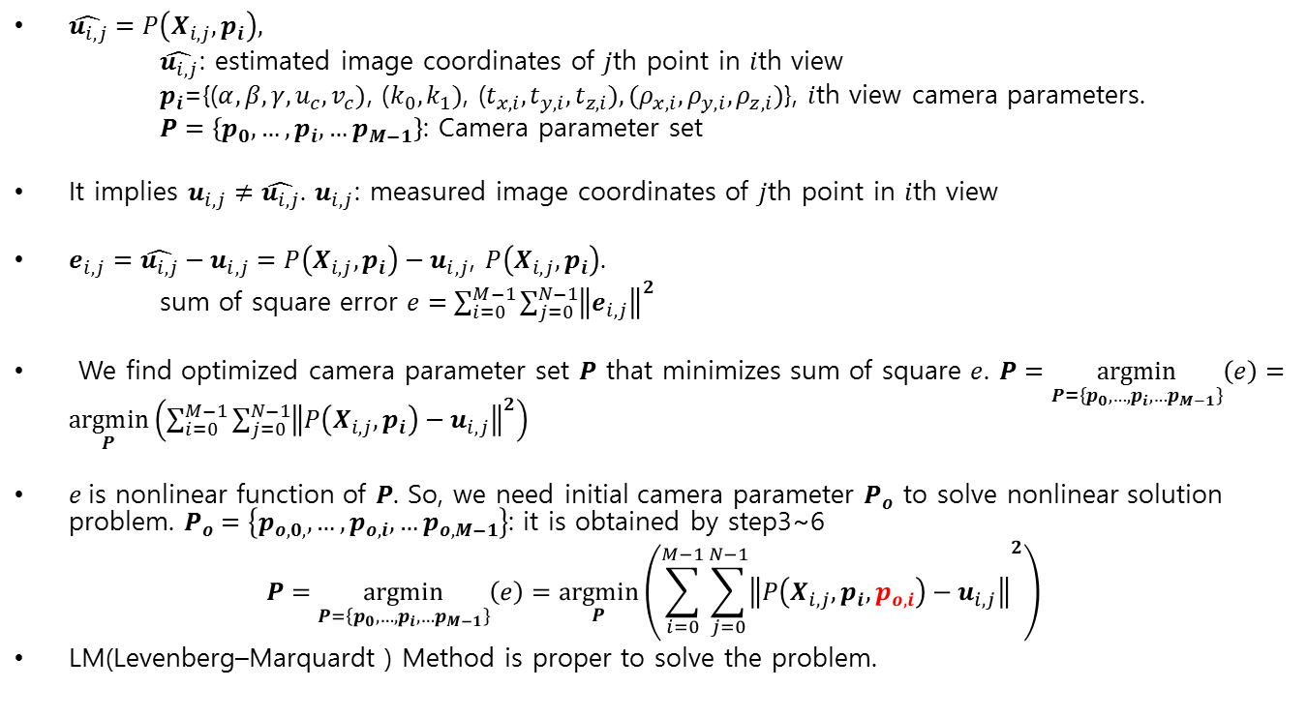
Optimization Method
$\hat{u_{i,j}}=P\left(X_{i,j},p_{i}\right),$
$\hat{u_{i,j}}$: estimated image coordinates of $j$th point in $i$th view
$p_{i}\text{=\{}\text{(}α,β,γ,u_{c},v_{c})\text{, (}k_{0},k_{1})\text{, (}t_{x,i},t_{y,i},t_{z,i}),(ρ_{x,i},ρ_{y,i},ρ_{z,i})\text{\}}$, $i$th view camera parameters.
$P=\left\{p_{0},…,p_{i},…p_{M−1}\right\}$: Camera parameter set
It implies $u_{i,j}≠\hat{u_{i,j}}$. $u_{i,j}$: measured image coordinates of $j$th point in $i$th view
$e_{i,j}=\hat{u_{i,j}}−u_{i,j}=P\left(X_{i,j},p_{i}\right)−u_{i,j}$, $P\left(X_{i,j},p_{i}\right)$.
sum of square error $e=\sum_{i=0}^{M−1}{{\sum_{j=0}^{N−1}{\left\|e_{i,j}\right\|}}^{2}}$
We find optimized camera parameter set $P$ that minimizes sum of square $e$. $P=\underset{P=\left\{p_{0},…,p_{i},…p_{M−1}\right\}}{argmin}\left(e\right)=\underset{P}{argmin}\left(\sum_{i=0}^{M−1}{{\sum_{j=0}^{N−1}{\left\|P\left(X_{i,j},p_{i}\right)−u_{i,j}\right\|}}^{2}}\right)$
$e$is nonlinear function of $P$. So, we need initial camera parameter $P_{o}$ to solve nonlinear solution problem. $P_{o}=\left\{p_{o,0,},…,p_{o,i},…p_{o,M−1}\right\}$: it is obtained by step3~6
$$P=\underset{P=\left\{p_{0},…,p_{i},…p_{M−1}\right\}}{argmin}\left(e\right)=\underset{P}{argmin}\left(\sum_{i=0}^{M−1}{{\sum_{j=0}^{N−1}{\left\|P\left(X_{i,j},p_{i},p_{o,i}\right)−u_{i,j}\right\|}}^{2}}\right)$$
LM(Levenberg–Marquardt ) Method is proper to solve the problem.

Slide 42
Mathematic Tools
Linear Solution Problem
Pseudo inverse
- SVD(singular value decomposition)
Non linear Solution Problem
Newton Method
LM Method
Geometric Transform
Affine Transform
Homography
Rodrigues Rotation Formula

Slide 43
Reference
Z. Zhang, A Flexible New Technique for Camera Calibration, ‎2000.
W. Burger, Zhang’s Camera Calibration Algorithm: In-Depth Tutorial and Implementation, 2016

